Slide 1
Machine Learning CSE - 403
Lecture - 03
K-Nearest Neighbor Classifier

Slide 2
Outline
Introduction to K- Nearest Neighbor Classifier
KNN Example
How to determine a good value for k?
Advantages and disadvantages of KNN
Weighted KNN

Slide 3
Introduction to KNN
K-Nearest Neighbour is one of the simplest Machine Learning algorithms based on Supervised Learning technique.
K-NN algorithm assumes the similarity between the new case/data and available cases and put the new case into the category that is most similar to the available categories.
K-NN algorithm stores all the available data and classifies a new data point based on the similarity. This means when new data appears then it can be easily classified into a well suite category by using K- NN algorithm.

Slide 4
Introduction to KNN
K-NN algorithm can be used for Regression as well as for Classification but mostly it is used for the Classification problems.
It is also called a lazy learner algorithm because it does not learn from the training set immediately instead it stores the dataset and at the time of classification, it performs an action on the dataset.
KNN algorithm at the training phase just stores the dataset and when it gets new data, then it classifies that data into a category that is much similar to the new data.

Slide 5
KNN Algorithm
The K-NN working can be explained on the basis of the below algorithm:
Step-1: Select the number K of the neighbors
Step-2: Calculate the Euclidean distance from all data points
Step-3: Take the K nearest neighbors as per the calculated Euclidean distance.
Step-4: Among these k neighbors, count the number of the data points in each category.
Step-5: Assign the new data points to that category for which the number of the neighbor is maximum.
Step-6: Our model is ready.

Slide 6
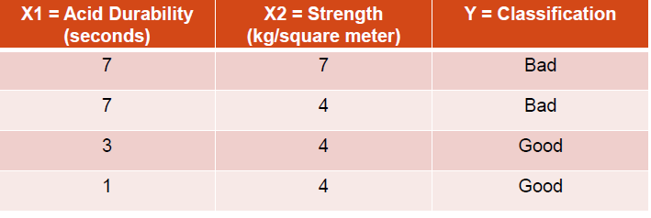
KNN Example
We are testing with two attributes (acid durability and strength) to classify whether a special paper tissue is good or not.
Here are four training samples :
Now the factory produces a new paper tissue that passes the laboratory test with X1 = 3 and X2 = 7.
Guess the classification of this new tissue.

Slide 7
KNN Example
Step 1 : Initialize and Define k.
Lets say, k = 3 (Always choose k as an odd number if the number of attributes is even to avoid a tie in the class prediction)
Step 2 : Compute the distance between input sample and training sample
Co-ordinate of the input sample is (3,7).
Instead of calculating the Euclidean distance, we calculate the Squared Euclidean distance.

Slide 8
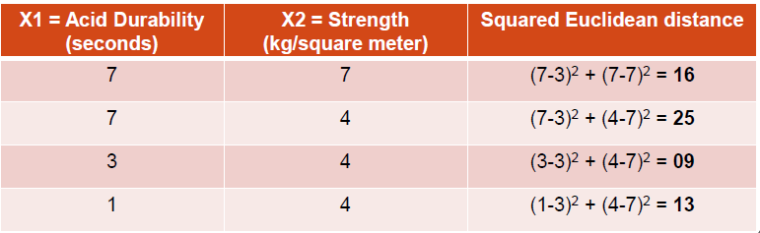
KNN Example
Step 2 (Continued)

Slide 9
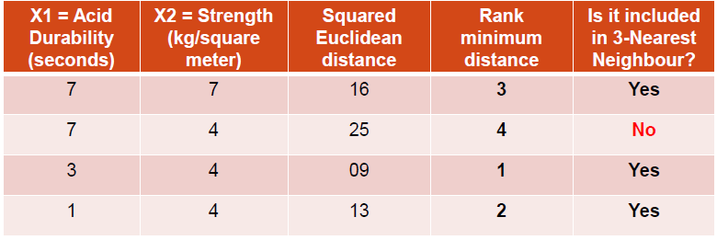
KNN Example
Step 3 : Sort the distance and determine the nearest neighbours based on the minimum distance :

Slide 10
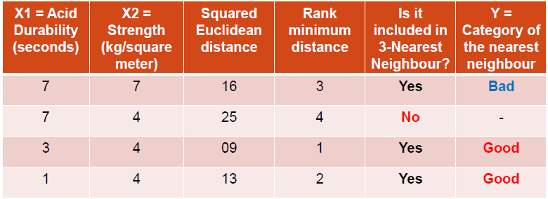
KNN Example
Step 4 : Take 3-Nearest Neighbors:
Gather the category Y of the nearest neighbors.

Slide 11
KNN Example
Step 5 : Apply simple majority
Use simple majority of the category of the nearest neighbors as the prediction value of the query instance.
We have 2 “good” and 1 “bad”.
Thus we conclude that the new paper tissue that passes the laboratory test with X1 = 3 and X2 = 7 is included in the “good” category.

Slide 12
How to determine a good value for k?
There is no particular way to determine the best value for "K", so we need to try some values to find the best out of them. The most preferred value for K is 5.
A very low value for K such as K=1 or K=2, can be noisy and lead to the effects of outliers in the model.
Large values for K are good, but it may find some difficulties.
we use a test set to estimate the error rate of the classifier. The k value that gives the minimum error rate may be selected.
Interesting relation to find k for large sample data :
k = sqrt(n)/2 (where n is number of examples)

Slide 13
Advantages of KNN
It is robust to the noisy training data.
Very simple and intuitive.
Good classification if the number of samples is large enough.

Slide 14
Disadvantages of KNN
Choosing k may be tricky
The computation cost is high because of calculating the distance between the data points for all the training samples.
No training stage, all the work is done during the test stage
This is actually the opposite of what we want. Usually we can afford training step to take a long time, but we want fast test step

Slide 15
Weighted KNN
Weighted KNN is a variant of the standard K-Nearest Neighbors (KNN) algorithm where nearer neighbors have more influence on the prediction than farther ones.

Slide 16
Why Weighted KNN?
In standard KNN, all k neighbors contribute equally, which can be misleading:
A far neighbor may influence the decision as much as a very close neighbor
Sensitive to noise when k is large
Weighted KNN fixes this by assigning higher weight to closer points.

Slide 17
How It Works (Intuition)
Closer data points are more important than farther ones.
Instead of simple voting, each neighbor votes with a weight based on its distance.

Slide 18

Weight Calculation (Most Common)
Inverse Distance Weighting

Slide 19
Weight Calculation test data = (3,7)
Training Instance | X1 | X2 | Output | Distance (d) | d² | Vote | Rank
1 | 7 | 7 | 0 | 4 | 16 | 1/16=0.06 | 3
2 | 7 | 4 | 0 | 5 | 25 | 1/25=0.04 | 4
3 | 3 | 4 | 1 | 3 | 9 | 1/9=0.11 | 1
4 | 1 | 4 | 1 | 3.6 | 12.96 | 1/12.96=0.08 | 2
Output 1- Sum = 0.08+0.11 = 0.19
Output 0- Sum = 0.06
Prediction : Output 1

Slide 20
Thank You

